Slide 1
Assembly Language Programming in 8085

Slide 2
Introduction
Programming languages are classified into following categories:
Machine language
Assembly Language
High level language

Slide 3
Introduction
Machine-language programs are usually written in binary code.
suitable for small and simple programs.
Program execution is very fast
program writing is difficult and time consuming

Slide 4
Introduction
To overcome the limitations of machine languages, assembly language was developed.
machine-level instructions are replaced by mnemonics.
Easier for a programmer to write programs
microprocessor specific
An assembly language program is not portable.
Assembly-language programs are translated to machine-level programs using a translator program known as assembler

Slide 5
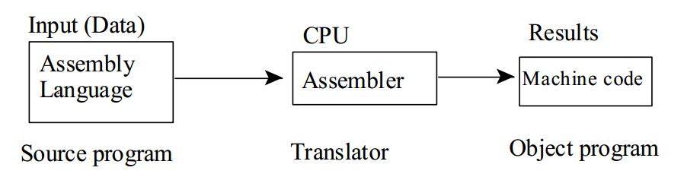
Introduction
The assembly language program is termed as the Source Program and the Final Machine code program is called the Object Program.

Slide 6
Introduction
The assembler has three main functions:
Replacement of symbolic opcode (mnemonics) with binary code.
Assign storage to instructions and output
Set the operand addresses

Slide 7
Instruction Format
Each statement in an assembly-language program consists of the following fields

Slide 8
Memory Address
It is the address of the memory location in which a program or a series of instructions are stored.
Machine code
Every instruction has a unique one-byte code called operation code.
Instructions are operated using data. Data may be of one byte or two bytes.
Machines codes are the hexadecimal representation of operation codes

Slide 9
Labels
Is used to identify the name of a memory location for storing data
The presence of a label in an instruction is optional.
When a label is present, it provides a symbolic name that can be used in branch instructions
used for conditional/unconditional jumping

Slide 10
Mnemonics
Each instruction has a specific mnemonic.
The mnemonic states the operation which will be executed.
Operands
depend on the type of instruction.
one-byte instruction has no operand.
Only one operand exists in two-byte instructions and a three-byte instruction has two operands which are separated by a comma.

Slide 11
Comments
Is used to understand the program easily. It is optional.
The comment field contains any combination of characters.
A comment may appears on a line and the first character of the line must be a semicolon.

Slide 12
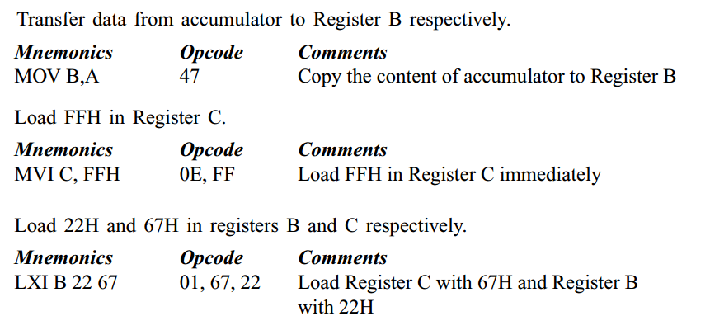
Examples

Slide 13
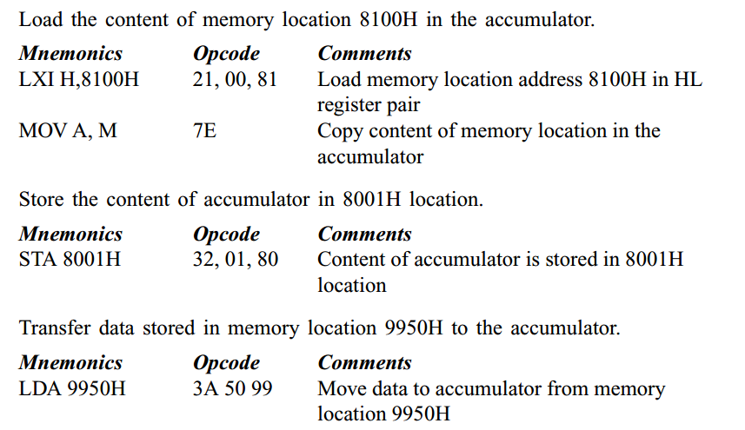
Examples

Slide 14
Addition of two 8 bit numbers (Sum is 8 bit)
Consider the first number 26H is stored in the memory location 8000H and the second number 62H is stored in the memory location 8001H.
The result after addition of two numbers is to be stored in the memory location 8003H.
Assume the program starts from the memory location 8500H.

Slide 15
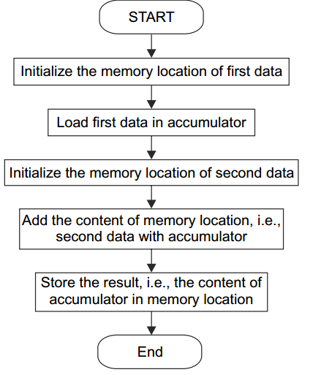
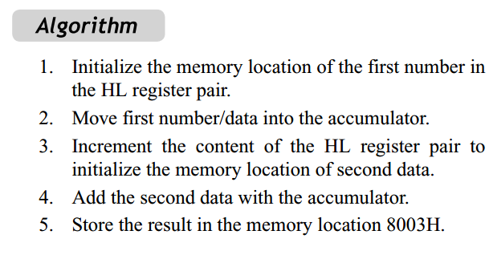
Addition of two 8 bit numbers (Sum is 8 bit)

Slide 16
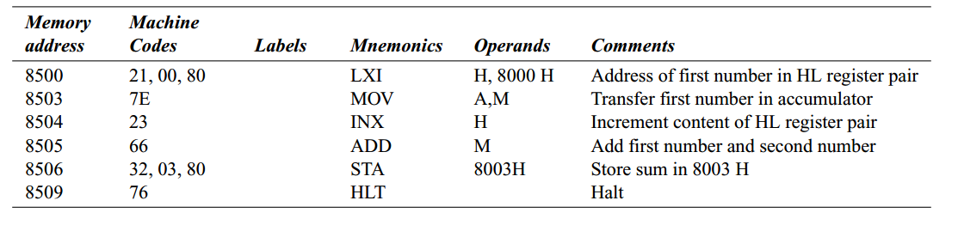
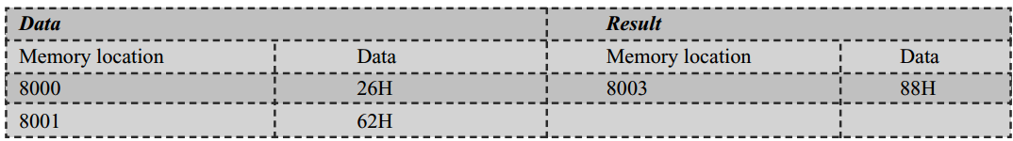
Addition of two 8 bit numbers (Sum is 8 bit)
Program
Output

Slide 17
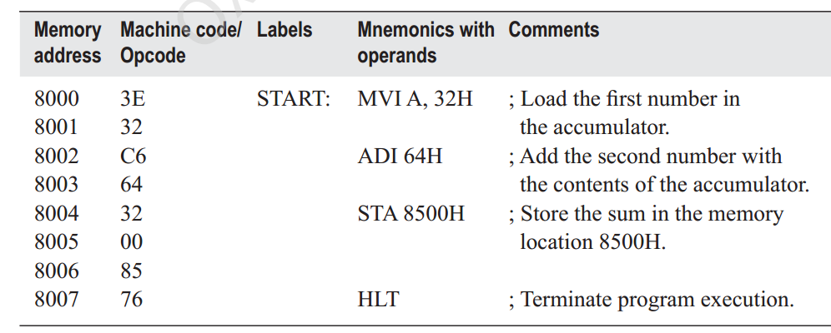
Addition of two 8 bit numbers (Sum is 8 bit)
Using immediate data

Slide 18
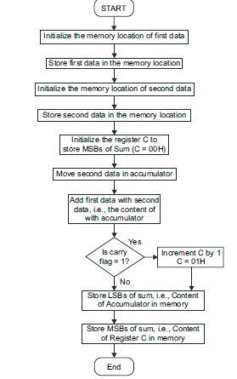
Program to add two 8 bit numbers, with sum is of 16 bits

Slide 19
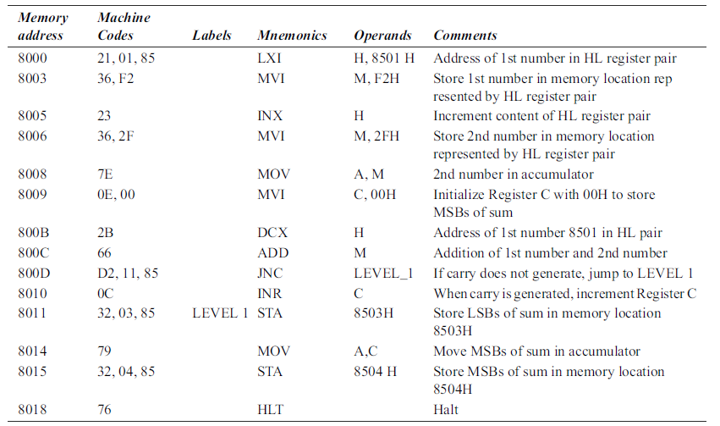

Slide 20
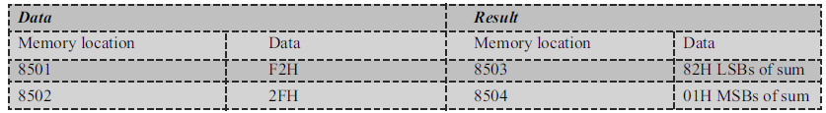

Slide 21
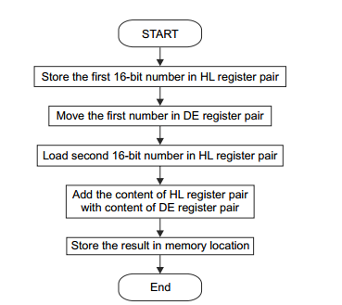
Add two 16 bit numbers (Sum is 16 bit)

Slide 22
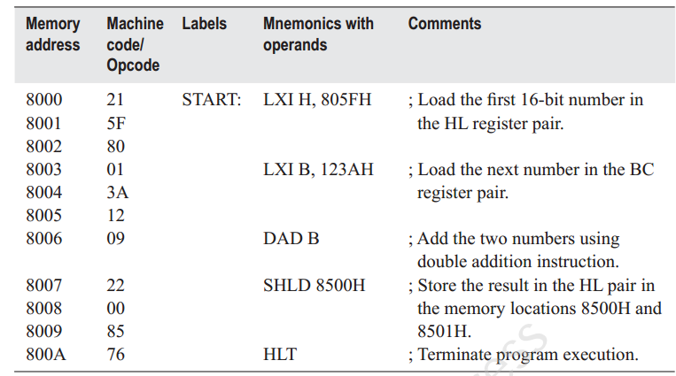
Program to add two 16 bit numbers

Slide 23
Example -2: Add two 16-bit numbers
Add the 16-bit number in memory locations 4000H and 4001H to the 16-bit number in memory locations 4002H and 4003H.
(4000H) = 15H
(4001H) = 1CH
(4002H) = B7H
(4003H) = 5AH
Result = 1C15 + 5AB7H = 76CCH
(4004H) = CCH
(4005H) = 76H

Slide 24
Program 1
LHLD 4000H ;Get first I6-bit number in HL
XCHG ;Save first I6-bit number in DE
LHLD 4002H ;Get second I6-bit number in HL
MOV A, E ;Get lower byte of the first number
ADD L ;Add lower byte of the second number
MOV L, A ;Store result in L register
MOV A, D ;Get higher byte of the first number
ADC H ;Add higher byte of the second number with CARRY
MOV H, A ;Store result in H register
SHLD 4004H ;Store I6-bit result in memory locations 4004H and 4005H
HLT ;Terminate program execution

Slide 25
Program 2
LHLD 4000H ; Get first I6-bit number
XCHG ; Save first I6-bit number in DE
LHLD 4002H ; Get second I6-bit number in HL
DAD D ; Add DE and HL
SHLD 4004H ; Store I6-bit result in memory locations 4004H and 4005H
HLT ; Terminate program execution

Slide 26
Subtraction of two 8 bit numbers
Data are stored in memory locations 8000H and 8001H. The result after subtraction will be stored in 8002H.
Steps:
1. Load address of first number in HL register pair.
2. Move first data into accumulator.
3. Increment the content of HL register pair.
4. Subtract the second data from accumulator.
5. Store the result in memory location 8002H.

Slide 27
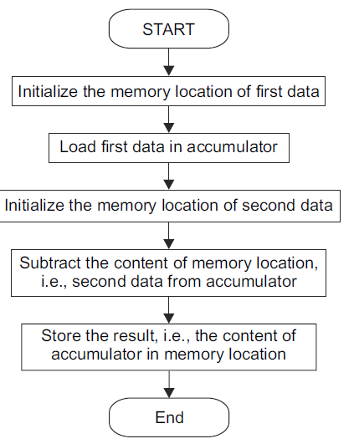

Slide 28
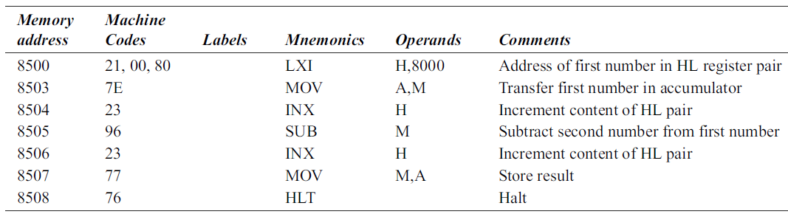
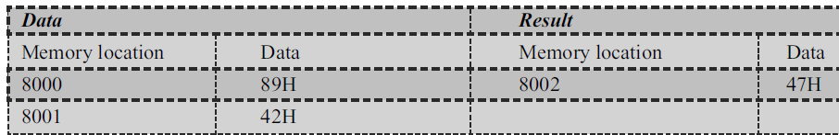

Slide 29
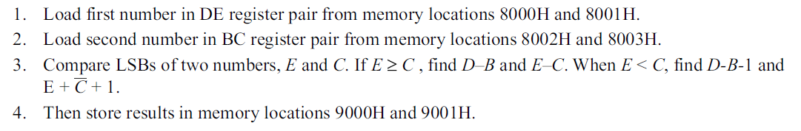
Subtraction of two 16 bit numbers

Slide 30
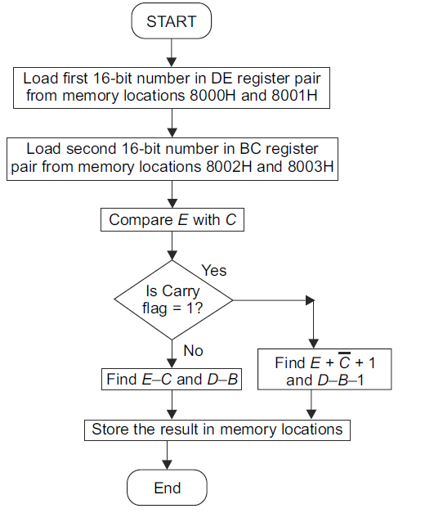

Slide 31
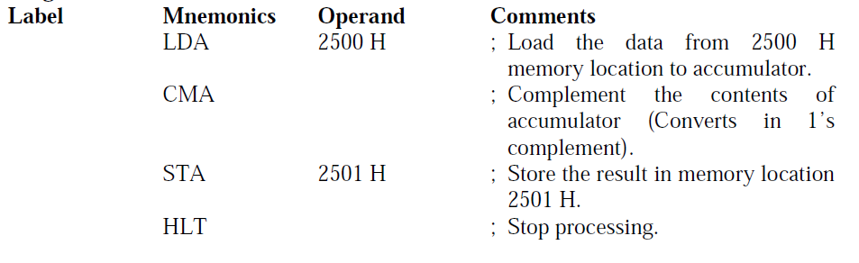
1’s Complement
Write an assembly language program of 8085 to find 1’s complement of the data stored in memory location 2500 H and the result is to be stored in memory location 2501 H.

Slide 32
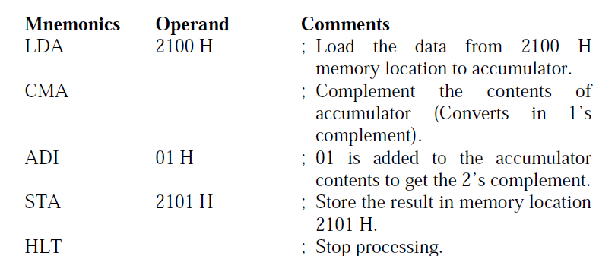
2’s Complement
Write an assembly language program of 8085 to find 2’s complement of the data stored in memory location 2100 H and the result is to be stored in memory location 2101 H.

Slide 33
Right shift, 8 bit of data
Write a program to shift an eight bit data four bits right. Assume data is in register C.
(4200H) = 58
Result = (4300H) = 08 and (4301H) = 05

Slide 34
MOV A, C
RAR
RAR
RAR
RAR
MOV C, A
HLT

